Slide 1

AI-powered Precision Agriculture using Autonomous Drones and IoT Sensors
Final Year Project – Proposal Presentation
Promoting Sustainable Farming Practices
By
Ayesha Gull – BSCS-2021-08
Muhammad Umer Farooq – BSCS-2021-19
Supervisor: Dr. Khawar Khurshid
Industrial Partner: Tkxel

Slide 2
Introduction
Our project aims to introduce sustainable farming practices in Pakistan by developing an AI-powered precision agriculture ecosystem using autonomous drones and advanced IoT sensors.
We seek to help farmers improve their productivity, resource efficiency, and profitability while also reducing the harmful environmental impact.

Slide 3
Problem Statement
Agriculture makes up about 19% of the GDP and employs 42.3% of the labor force [1], but faces several significant challenges.
Over 60% of Pakistan's population is food insecure, with 44% of children under 5 suffering from stunted growth [2].
Around 50% of water in surface irrigation in Pakistan is lost to inefficiencies [3] .

Slide 4
Objectives
Through the scope of this project, we aim to solve these issues using precision agriculture by:
Developing tools for crop health monitoring to maximize farming yield.
Optimizing irrigation practices to reduce water wastage.
Estimating crop yield.
Providing actionable insights and personalized recommendations to the farmers.
Promoting data-driven decision making in farming practices.

Slide 5
Literature Review
Papers reviewed for understanding the machine learning approaches currently being utilized for precision agriculture:
Emerging Line of Research Approach in Precision Agriculture: An Insight Study [4].
Utilizing Sentinel – 2 Satellite Imagery for Precision Agriculture over potato fields in Lebanon [5].
Land Cover Classification and Feature Extraction from National Agriculture Imagery Program (NAIP) Orthoimagery: A Review [6].

Slide 6
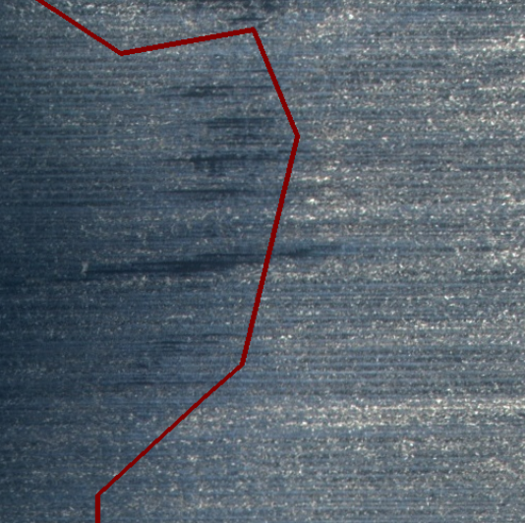
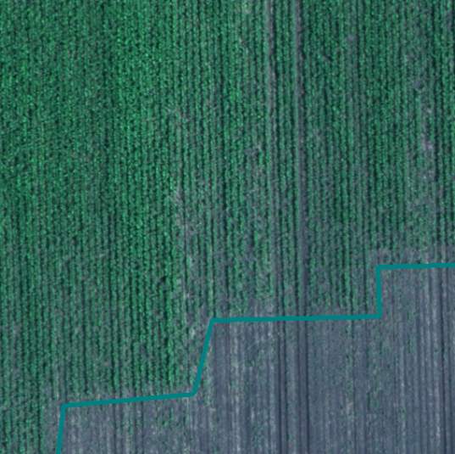
Datasets
We reviewed different datasets which we could utilize for training our models.
Datasets containing Aerial Imagery of Agricultural Fields:
Agriculture-Vision: Contains 94,986 high-quality aerial images from 3,432 farmlands across the US [7].
National Agriculture Imagery Program (NAIP): Contains high-resolution aerial imagery collected during the growing season of agricultural lands across the US [8].

Slide 7
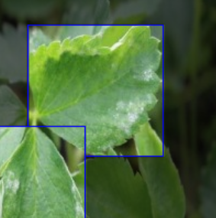
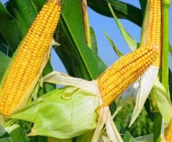
Datasets containing Images of Pest Infested Crops:
Detecting diseases Computer Vision Project: Contains images of crops infested by different pest-related diseases [9].
Datasets containing Annotated Crop Images:
Agricultural crops image classification: Contains images of 30
different types of crops including rice, sugarcane, maize, lemon, banana, coconut, jute etc. [10].

Slide 8
Related Existing Products
Few such product exist. Some of them are listed below:
Farmdar – a startup using AI & space technologies at scale for sustainability in agriculture catering to large organizations and agribusinesses [11].
کسان مددگار – a mobile app for farmers for the purpose of easier knowledge discovery and support [12].

Slide 9
Proposed Methodology
We’ve identified the following main components or entities which will interact among themselves to bring the application to completion:
Farm Field Sensors and Autonomous Drone
Edge Computing (Raspberry Pi)
Cloud Infrastructure
User Interface

Slide 10
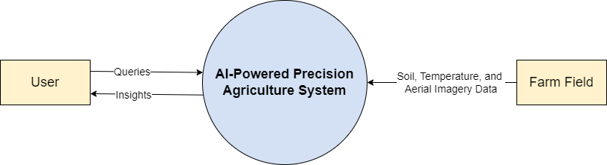
Level-0 DFD

Slide 11
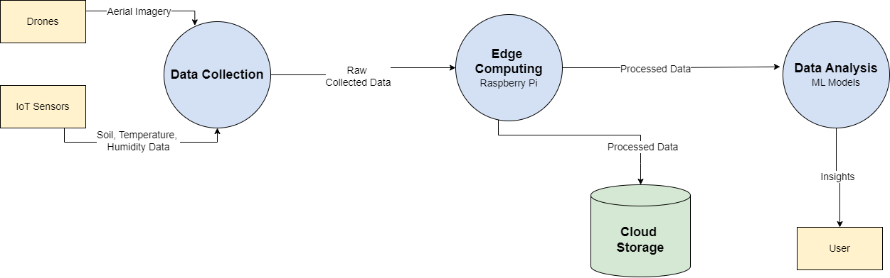
Level-1 DFD

Slide 12
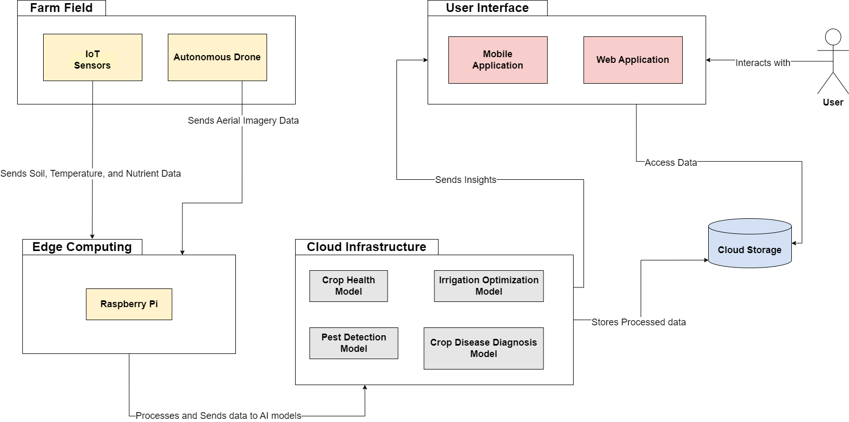
System Architecture Diagram

Slide 13








Hardware/Software Tools
Hardware Tools:
DJI Autonomous Drone with SDK support
IoT Sensors
Raspberry Pi
Software Tools:
Python (TensorFlow, Open CV)
Google Cloud IoT Core
Development Frameworks & Databases (React, Firebase etc.)

Slide 14
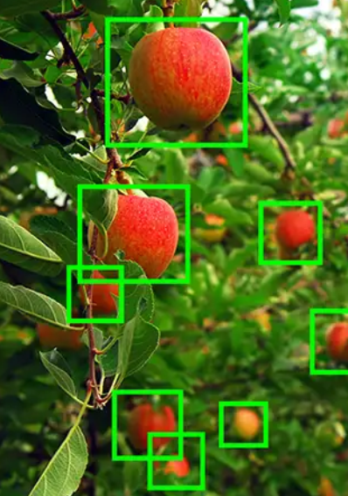
Object Detection Models
Yolov10: Fast, real-time, ideal for drone monitoring and edge computing.
Faster R-CNN: Highly accurate, suited for detailed agricultural datasets.
SSD: Balances speed and accuracy for real-time multi-object detection.
Retina-Net: Great for detecting small or subtle objects in crop fields.

Slide 15
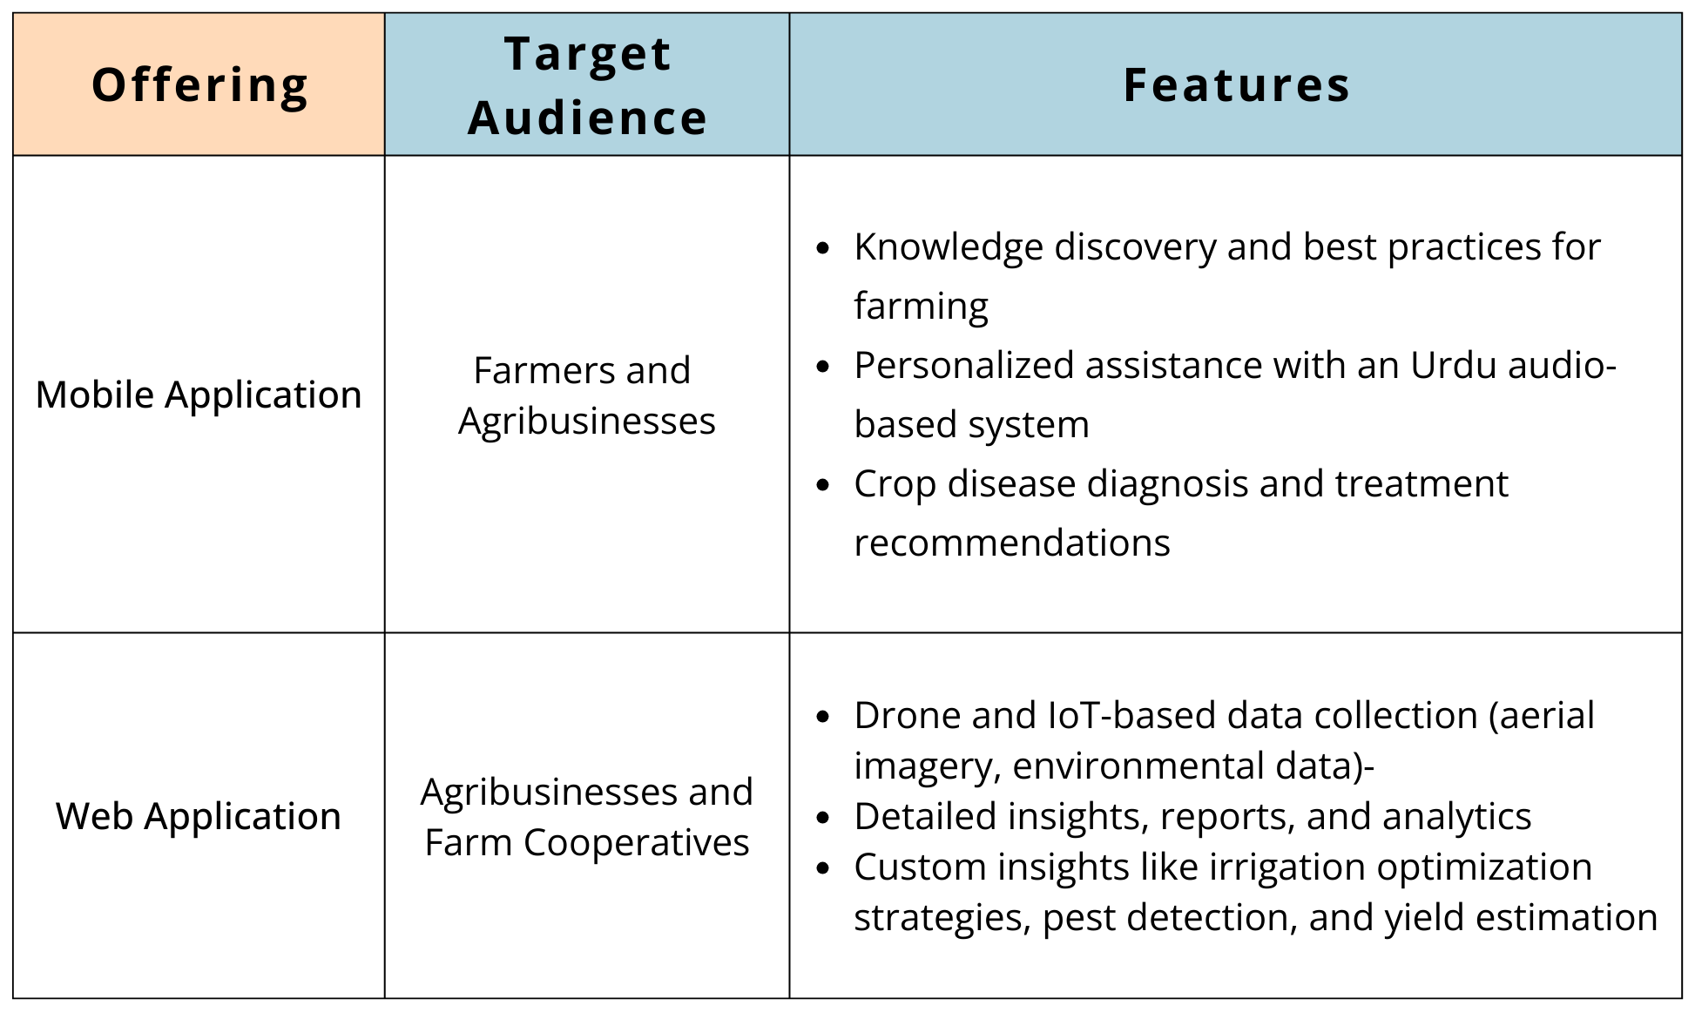
Product and Service Offering

Slide 16
Proposed Work Plan
Main modules/features are listed below:
Hardware Configuration and Setup
Datasets Collection and Preparation
Model Development
Edge Computing Integration
Cloud and Backend Infrastructure
User Applications Development
Tentative Estimate is to complete Model Development before the end of this semester.

Slide 17
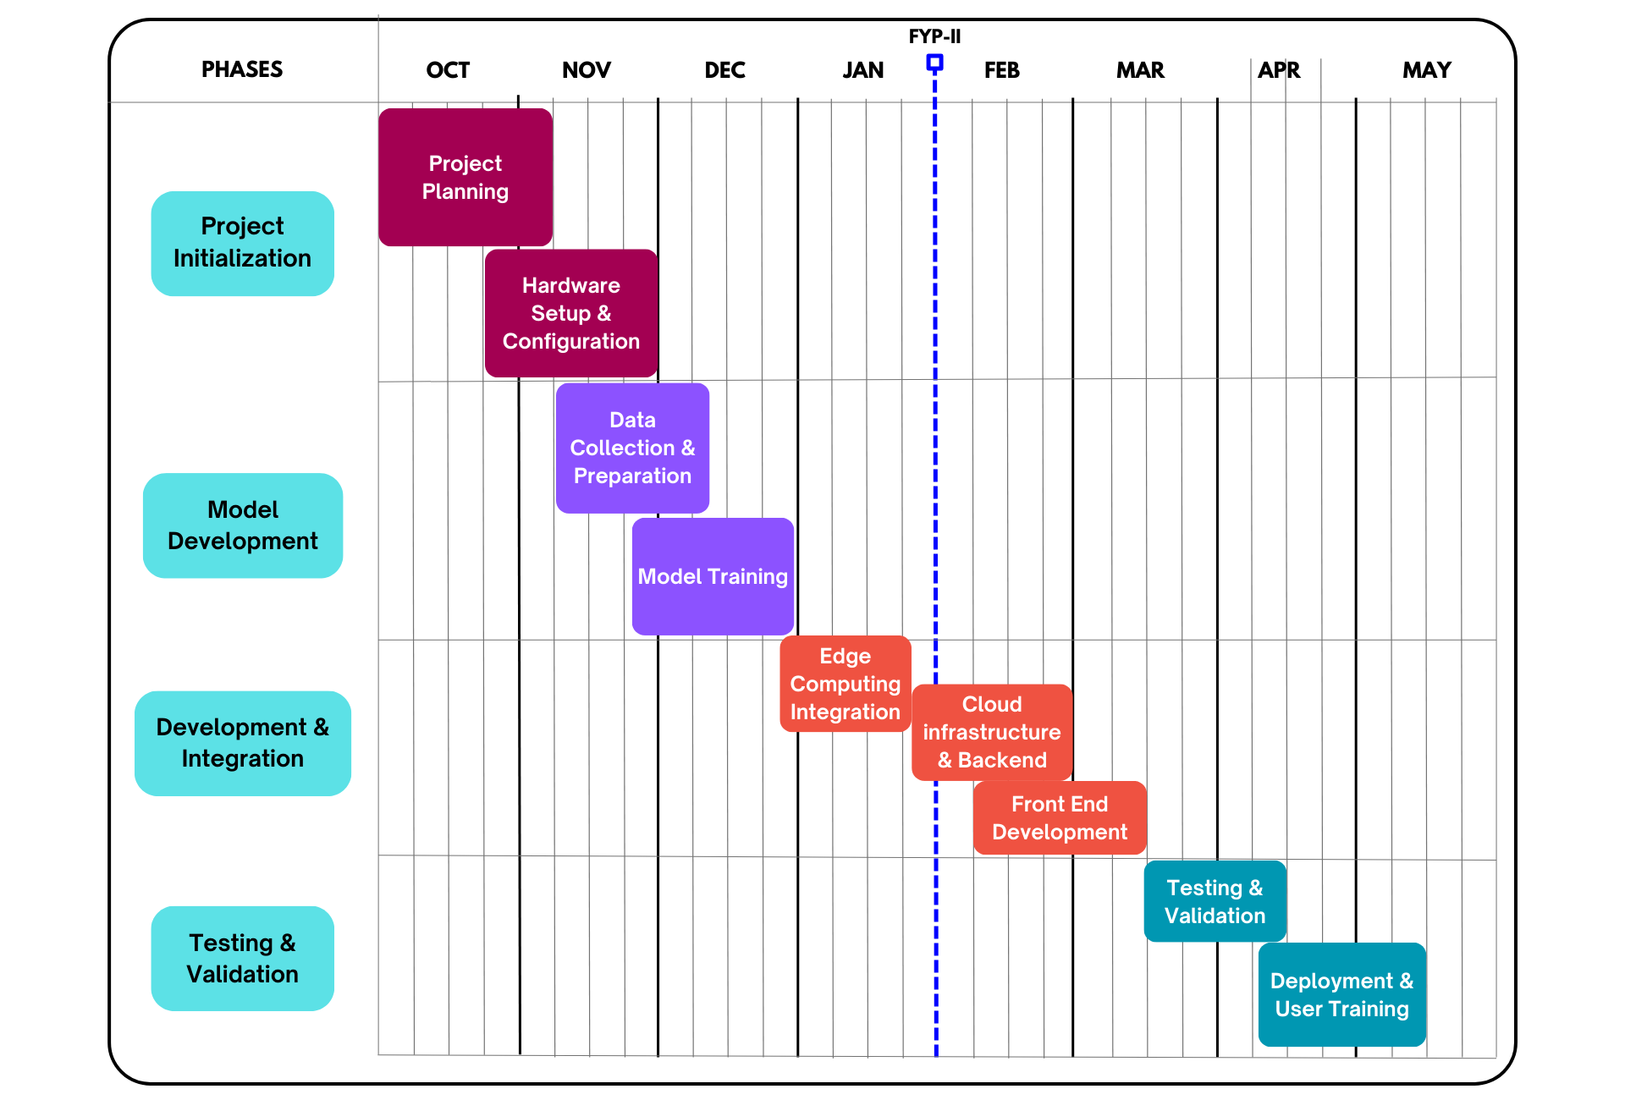
Gantt Chart

Slide 18
References
[1] Government of Pakistan, “Economic Survey of Pakistan 2016-17: Chapter 2 – Agriculture,” Finance Division, Islamabad, Pakistan, 2017. [Online]. Available: https://www.finance.gov.pk/survey/chapters_17/02-agriculture.pdf.
[2] World Food Programme, “Pakistan,” [Online]. Available: https://www.wfp.org/countries/pakistan.
[3] Pakistan Council of Research in Water Resources, “Water Scarcity in Pakistan: Issues and Options,” Islamabad, Pakistan, May 2018. [Online]. Available: https://www.pcrwr.gov.pk/wp-content/uploads/2021/07/Water-Scarcity-in-Pakistan-Issues-and-Options-May-18.pdf.
[4] I. B. A. Ibrahim, F. A. M. Al-Mansoori, and M. S. A. Hussain, “A Survey on Smart Agriculture Using IoT,” *International Journal of Advanced Computer Science and Applications*, vol. 12, no. 2, pp. 451-457, 2021. [Online]. Available: https://thesai.org/Publications/ViewPaper?Volume=12&Issue=2&Code=IJACSA&SerialNo=39.
[5] T. Al-Ali, M. El-Hussainy, and M. Khater, “Utilizing Sentinel – 2 Satellite Imagery for Precision Agriculture over Potato Fields in Lebanon,” in *Proceedings of the Pecora 20 Conference*, 2021. [Online]. Available: https://www.asprs.org/a/publications/proceedings/Pecora20/137_Paper.pdf.

Slide 19
[6] R. T. Shrestha, D. L. O. Dandois, and B. W. Lillesand, “Evaluation of Satellite Imagery for Precision Agriculture,” *Photogrammetric Engineering & Remote Sensing*, vol. 83, no. 11, pp. 923-932, Nov. 2017. [Online]. Available: https://www.asprs.org/a/publications/pers/2017journals/PERS_Nov16_PUBLIC/HTML/files/assets/common/downloads/page0023.pdf.
[7] Agriculture Vision, “Agriculture Vision 2020: Datasets,” [Online]. Available: https://www.agriculture-vision.com/agriculture-vision-2020/dataset.
[8] NASA, “National Agriculture Imagery Program (NAIP),” [Online]. Available: https://data.nasa.gov/dataset/National-Agriculture-Imagery-Program-NAIP-/i9rr-r6n5/about_data.
[9] M. W. Azam, “Agricultural Crops Image Classification,” Kaggle, [Online]. Available: https://www.kaggle.com/datasets/mdwaquarazam/agricultural-crops-image-classification .
[10] Artificial Intelligence, “Detecting Diseases in Crops,” Roboflow, [Online]. Available: https://universe.roboflow.com/artificial-intelligence-82oex/detecting-diseases?ref=blog.roboflow.com .
[11] Farmdar, [Online]. Available: https://www.farmdar.ai/.
[12] کسان مددگار, [Online]. Available: https://play.google.com/store/apps/details?id=com.app.concave_agritech&hl=en

Slide 20
Thank You

